Slide 1

Car Rental System
By
Niveditha
Naveen
Avaljot

Slide 2

Introduction
We have chosen to produce a Car Rental system. In our system, Customer can rent a car based on make and a model.
Our system provides customer to have different pick-up and drop-off locations and will impose late fee if the rental car is returned beyond the return date and time.
The Customers can purchase car rental insurance which is optional and can use up to one discount coupon to their final bill. Customers who have membership will be by default given a 10% discount in their final bill.

Slide 3
Assumptions
Each booking is associated with only one car reservation at a time.
Car available in the system should be present at some location.
Billing may or may not have discount code applied.
Not all Booking is associated with billing because of the cancelled bookings.
Booking may or may not have rental insurance because customer may have his own insurance.

Slide 4
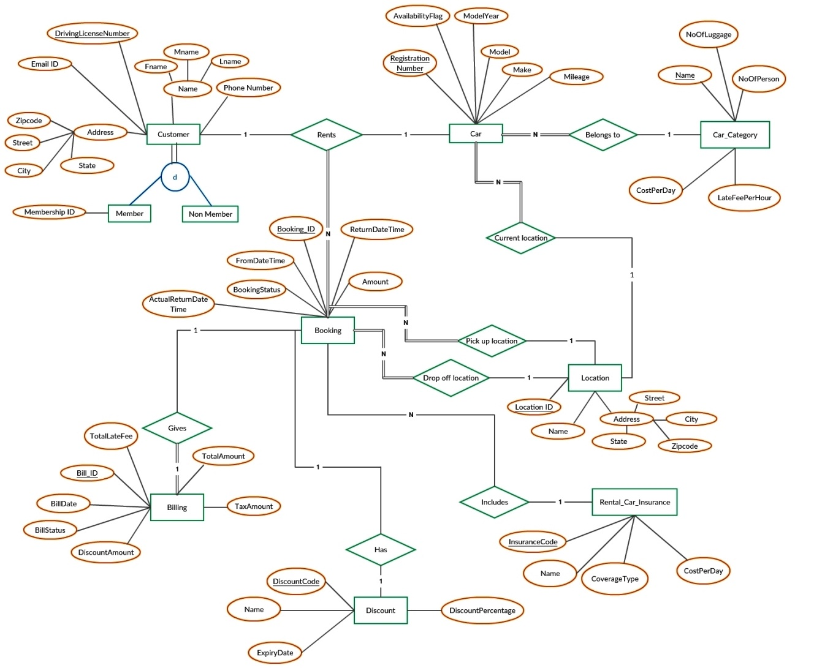
ER Diagram

Slide 5
Functional dependencies
violating 3NF rules
The Following transitive dependencies exists in the relational schema.
Customer_Details table
DL_number -> Zipcode
Zipcode -> State, City
Car table
Registration_number -> Model_name
Model_name -> Make
Location_Details table
Location_id -> Zipcode
Zipcode -> State, City

Slide 6
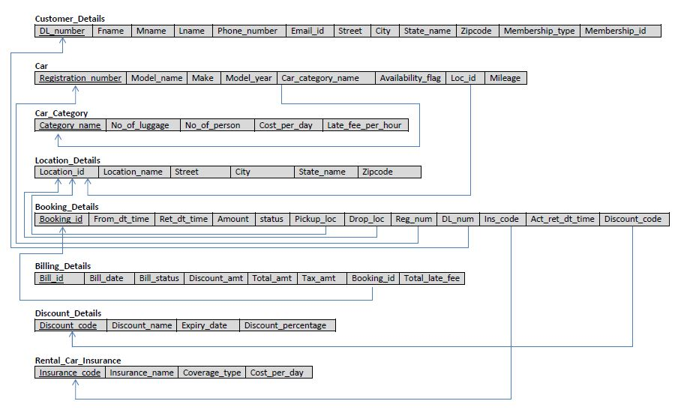
Final Relational Schema

Slide 7
Stored Procedures
& Triggers
Stored procedures:
CALCULATE_LATE_FEE_AND_TAX
CALCULATE_DISCOUNT_AMOUNT
GENERATE_REVENUE_REPORT
Triggers:
GENERATE_BILLING
UPDATE_CAR_DETAILS

Slide 8
Stored Procedures
& Triggers continued…
CALCULATE_LATE_FEE_AND_TAX
Given the return date and time while booking, actual return date and time, registration number of the car and booking amount, this procedure calculates the total late fee using late fee per hour, return date and time and the actual return date and time of the rental car.
Once the total late fee is obtained, it is added to the amount and the total tax is calculated.
Tax is calculated as 8.25% of the total amount (i.e. Amount + total late fee).

Slide 9
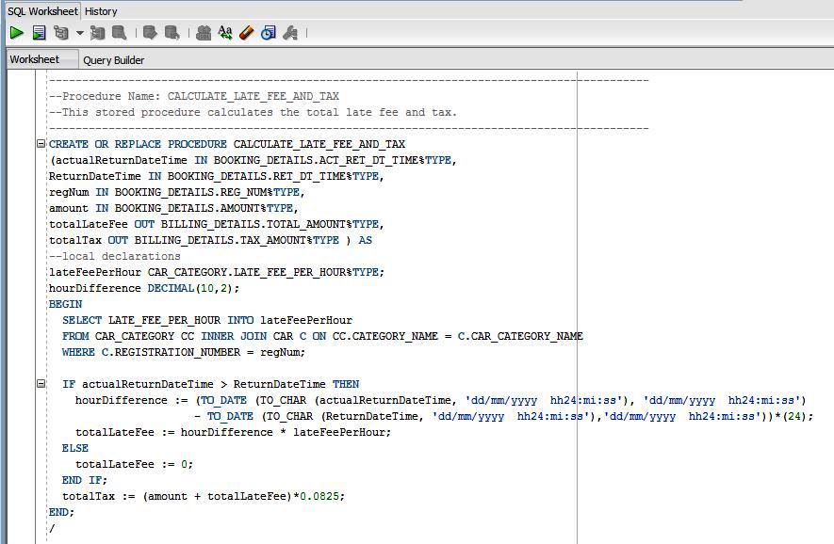
Stored Procedures
& Triggers continued…

Slide 10
Stored Procedures
& Triggers continued…
CALCULATE_DISCOUNT_AMOUNT
Given the driving license number, total amount and the discount code, this procedure calculates the discount amount based on the discount code used by the customer while booking the rental car.
Additional 10% discount is given to the customers who have membership ID.
The discount amount is calculated on the total amount obtained after adding the late fee and the tax amount.
For Non members:
Discount amount = total amount * ((discountPercentage)/100)
For members:
Discount amount = total amount * ((discountPercentage+10)/100)

Slide 11
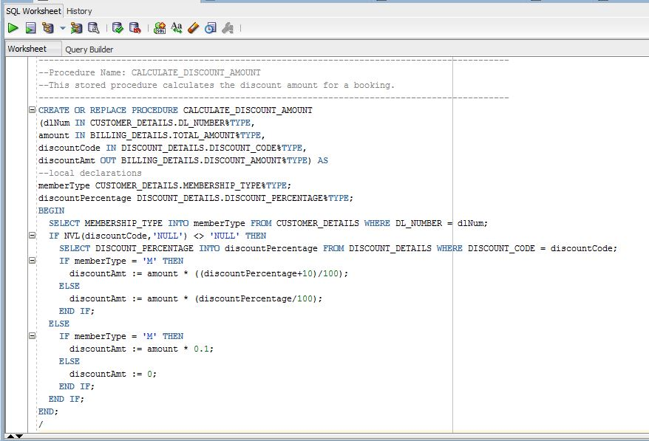
Stored Procedures
& Triggers continued…

Slide 12
Stored Procedures
& Triggers continued…
GENERATE_REVENUE_REPORT
This procedure generates monthly revenue report based on the bill date, location and car categories.
For every location, the no of cars in each category along with the total revenue is calculated and a monthly report is generated.
This stored procedure makes use of cursor for report generation.

Slide 13
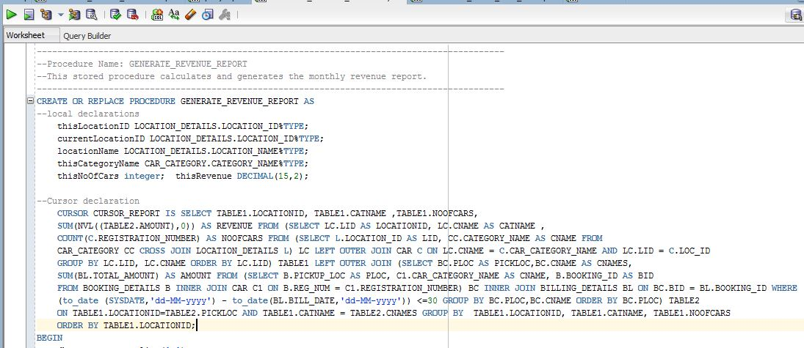
Stored Procedures
& Triggers continued…

Slide 14
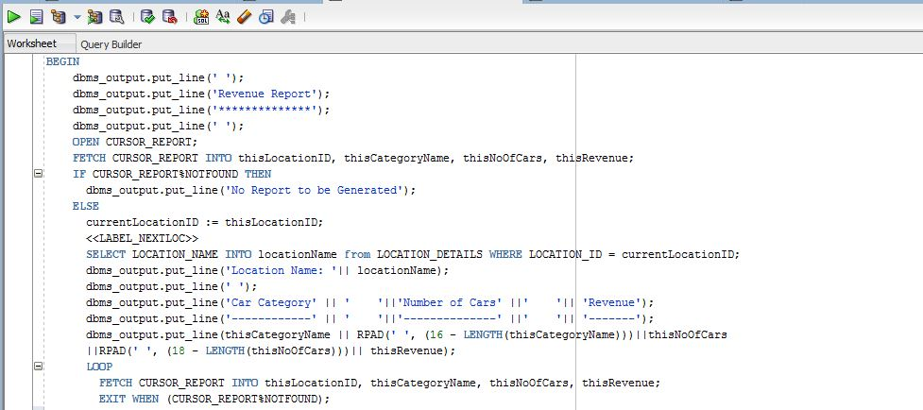
Stored Procedures
& Triggers continued…

Slide 15
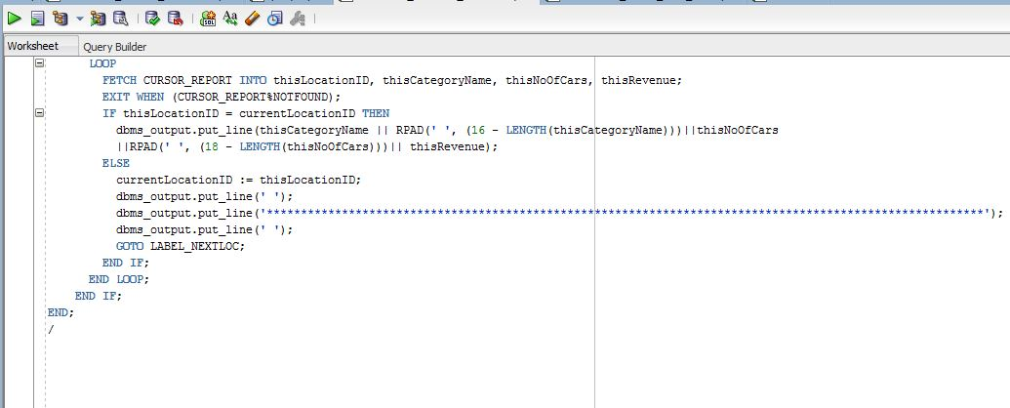
Stored Procedures
& Triggers continued…

Slide 16
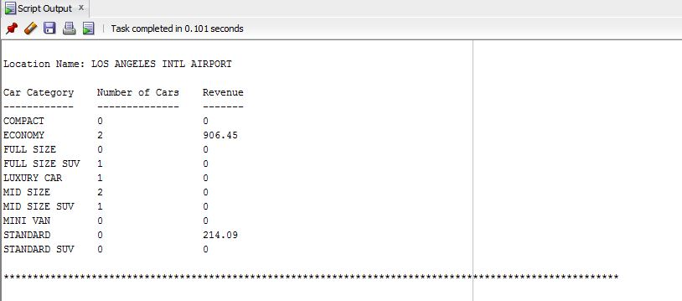
Stored Procedures
& Triggers continued…
Sample report:

Slide 17
Stored Procedures
& Triggers continued…
GENERATE_BILLING
This trigger inserts a tuple into the Billing_Details table when the actual return date is updated and booking status is updated to ‘R’ in Booking_Details table.
It generates Bill when the rental car is returned.
This is triggered whenever a row is updated in Booking_Details table.

Slide 18
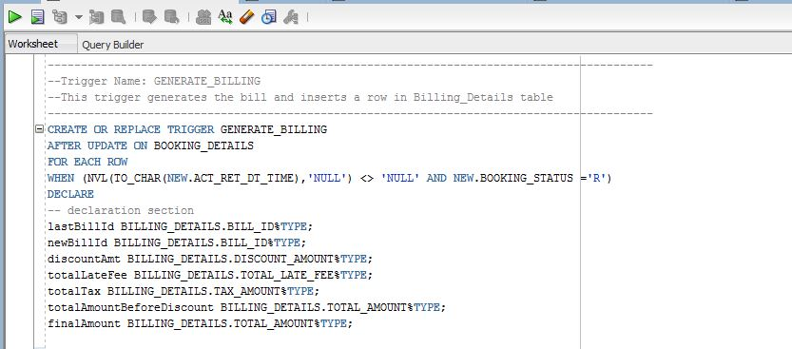
Stored Procedures
& Triggers continued…

Slide 19
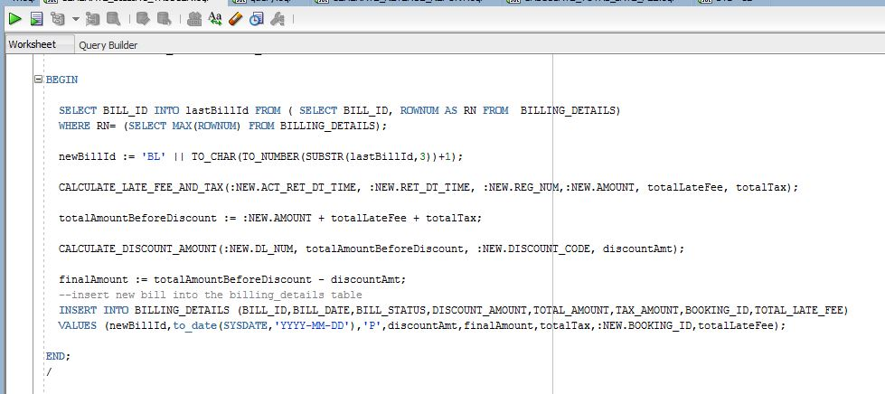
Stored Procedures
& Triggers continued…

Slide 20
Stored Procedures
& Triggers continued…
UPDATE_CAR_DETAILS
This trigger updates the availability flag, mileage and location of the car in the car table when the actual return date is updated or when a booking is cancelled.
This is triggered whenever a row is updated in Booking_Details table.

Slide 21
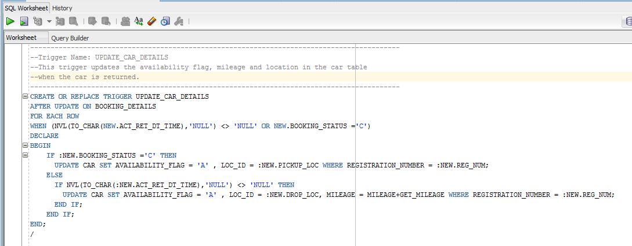
Stored Procedures
& Triggers continued…

Slide 22

Thank you!
Questions?

